Slide 1

SteelCentral 应用性能管理 解决方案

Slide 2
信息系统管理的总体框架
业务
管理
Business
Management
业务管理
业务服务，业务影响分析，仿真
性能管理
Performance Management
性能管理
应用感知、监控、预警、定位
流量分析，依赖关系，可视化
SLA报告，计费，容量规划
运行管理
拓扑管理，资产/库存管理，
故障管理，事件管理，警报，排错
运行管理
Operation Management
网元管理
Element Management
网元管理
网络设备的安装，配置与维护
“在任何网络与应用的生命周期中，性能管理都是每个阶段的最为策略性的工作。”
Paul Bugala – IDC

Slide 3
各种信息系统管理解决方案的定位
业务
管理
Business
Management
业务管理
HP、IBM、BMC、天旦 BPC …
性能管理
Performance Management
性能管理
Riverbed APM、Riverbed NPM
运行管理
IBM、HP、CA、BMC、SolarWinds、北塔、神州泰岳
运行管理
Operation Management
网元管理
Element Management
网元管理
华为、华三、思科 …
“在任何网络与应用的生命周期中，性能管理都是每个阶段的最为策略性的工作。”
Paul Bugala – IDC

Slide 4
关于应用性能管理
为什么需要应用性能管理？
现代应用的复杂度
如何着手？
应用性能问题需要全面的解决方案
NPM – 首先分清是网络还是应用的问题？
APM – 着手探查应用内部的问题
NPM能够帮助您……
了解网络流量与应用的关系
找出造成延迟的真正原因
某个网段？某台服务器？某个用户？
提供证据
APM能够帮助您……
在应用服务器内部究竟发生了什么？
哪个进程？哪个用户？哪个call？哪个SQL语句？……
提供证据

Slide 5





现代应用的复杂性
应用
App 1
App 200
应用架构
第3方服务
IT 基础架构
虚拟化
Network
DB
Storage
Server
Network
DB
Storage
Server
从网络到系统到应用代码，任何一个组件的问题都会影响应用的性能

Slide 6





IT部门常常遇到的状况
整体应用性能
IT部门处理用户的投诉…
“唉,今天系统又是好慢！IT的人都在干嘛！！！”
End User 最终用户
“是网络问题"
应用的Log都很正常
沒有任何Exceptions
我們已经压力测试过了!
“网络没问题”
网络流量不大
Ping 时延都正常
Traceroute 也沒问题
应用部门
网络部门
“与我无关,可能是网络
CPU 是正常的
内存使用率也很低
Disk I/O 一切正常
“沒有什么异常现象”
交易数比平常多一点， 不过看起来也是正常的
主机系统部门
DBA
问题从哪下手? 叫每个部门硬找出问题?
问题时有时无，飘忽不定…怎么办?

Slide 7
应用性能管理需要非常全面的解决方案
客户端浏览器
起始
网页渲染时间
EUE
结束
广域网
服务请求
网络、带宽、延迟、丢包
服务响应
网络、带宽、延迟、丢包
网络
传输
TCP/IP 协议栈
IIS Native Pipeline
处理排队
性能
指标
Web服务器
.NET Worker Process
代码执行
代码执行
代码 执行
Riverbed SteelCentral
局域网
网络、带宽、延迟
网络、带宽、延迟
网络
传输
TCP/IP Stack
Apache
处理排队
性能
指标
WAS Thread Pool
处理排队
App服务器
WAS JVM
代码执行
代码执行
代码
执行
远程调用
Web服务，数据库…
网络
传输

Slide 8





Riverbed Steelcentral APM 解决方案
NPM
网络性能管理
APM
应用性能管理
最终用户体验
8

Slide 9




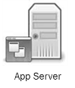
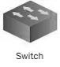

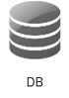
SteelCentral – 端到端、全面的应用性能管理
Portal
集中的应用可视化
NetSensor
SNMP/WMI
NetProfiler
Flow 数据
AppResponse
网络数据包
AppInternals
Java, .net,
db, system
….
特定领域的监控， 分析与数据聚合
NetShark
SteelFusion
SteelHead
NetShark-V
NetShark-V
全面的数据捕获

Slide 10
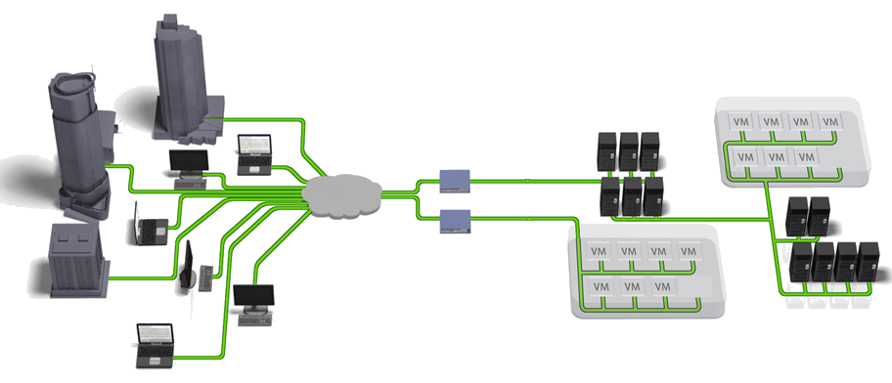

SteelCentral 架构
NetSensor
AppInternals
Web analyzer
AppResponse
Applications
Web
NetProfiler
Applications
Databases
Portal
SteelCentral Portal
集中的展现、报告与分析，性能管理门户
NetProfiler
Flow收集与分析
展现流量成分、长期趋势
NetSensor
SNMP/WMI
网络/服务器节点健康状态
WebAnalyzer
web前端应用性能指标分析
AppInternals
后端服务器、代码性能深度分析与展现 （Java & .Net, 等）
AppResponse
抓包、存储与网络性能分析
Web / VoIP / Citrix / SQL 应用层分析

Slide 11
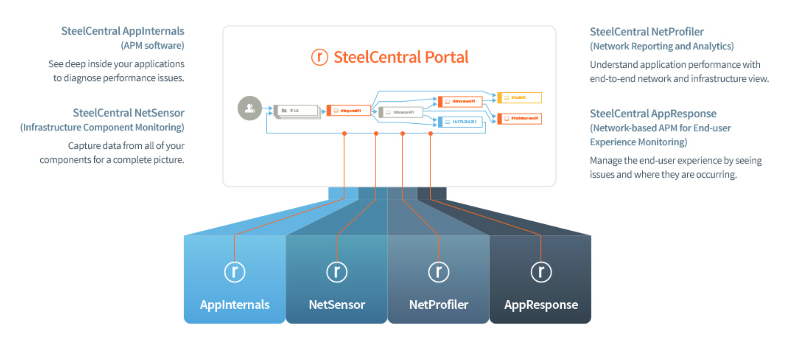
SteelCentral Portal
SteelCentral AppInternals
监控用户体验并追踪交易至代码级别，以提供应用性能可视性
SteelCentral NetProfiler
利用端到端的网络性能监控，排查网络与性能问题
SteelCentral AppResponse
监控真实用户的应用性能体验并修复应用性能问题
SteelCentral NetSensor
从所有设备获取数据，以获得完整的应用性能视图
SteelHead
优化广域网络流量
SteelHead

Slide 12
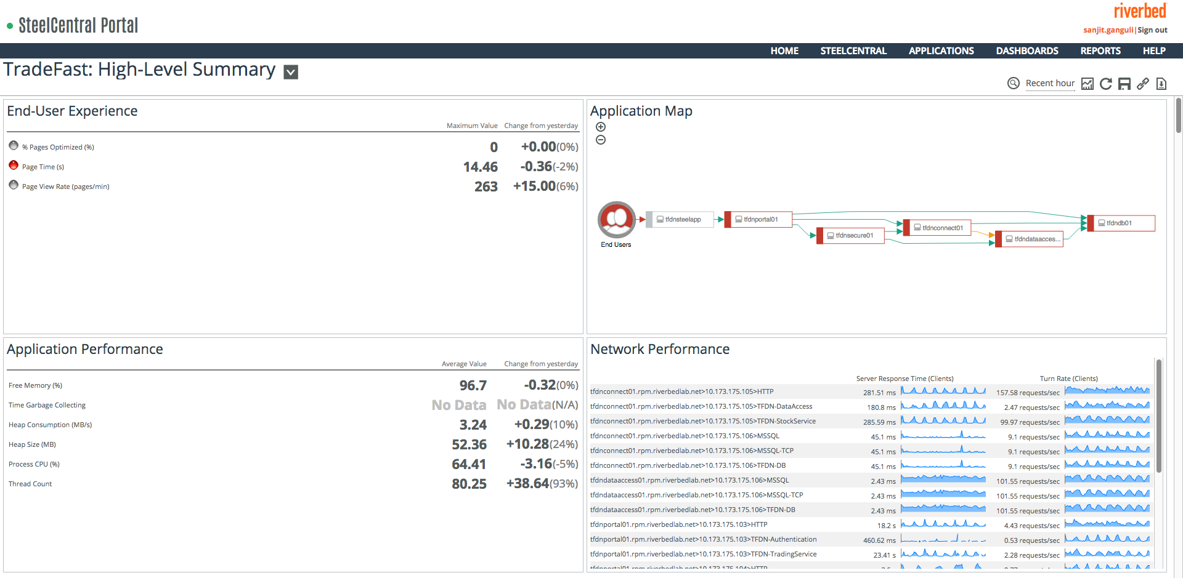
SteelCentral Portal – 以应用为中心的多视角监控视图
AppResponse: RTCC, request rate, response time, active connections, number of TCP resets, TCP retransmissions
NetProfiler: request rate, response time, active connections, number of TCP resets, TCP retransmissions
AppInternals: Health metrics (memory, heap consumption, heap size, process CPU, thread count, time garbage collecting), CPU, Disk, Memory, DB metrics
NetSensor: CPU, Disk, Memory

Slide 13
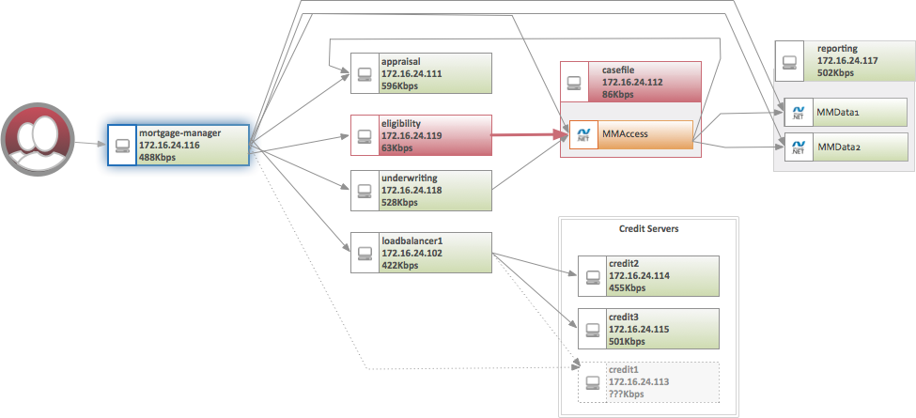
构建应用服务视图

Slide 14
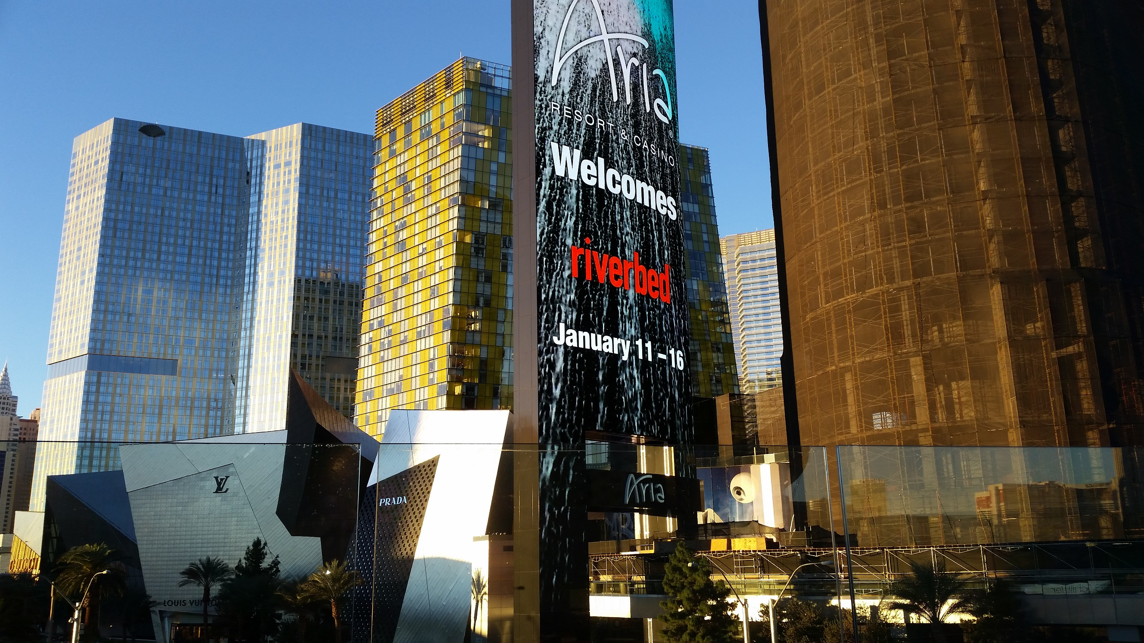
APM 查错示例

Slide 15
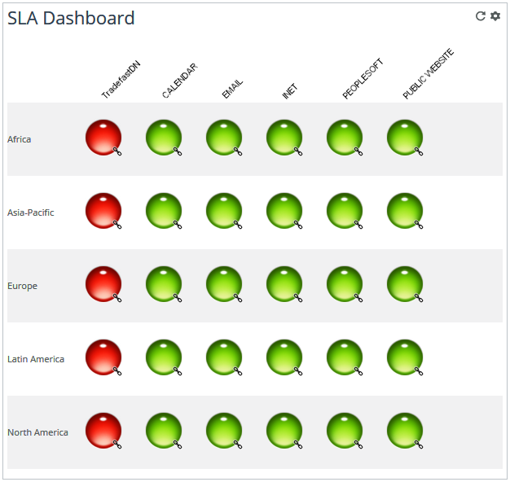
用户抱怨 TradeFastDN 性能差
只是这个用户还是所有用户受影响？
使用SLA Dashboards 来查看应用性能的总体表现
TradeFastDN 在所有用户区域都很慢

Slide 16
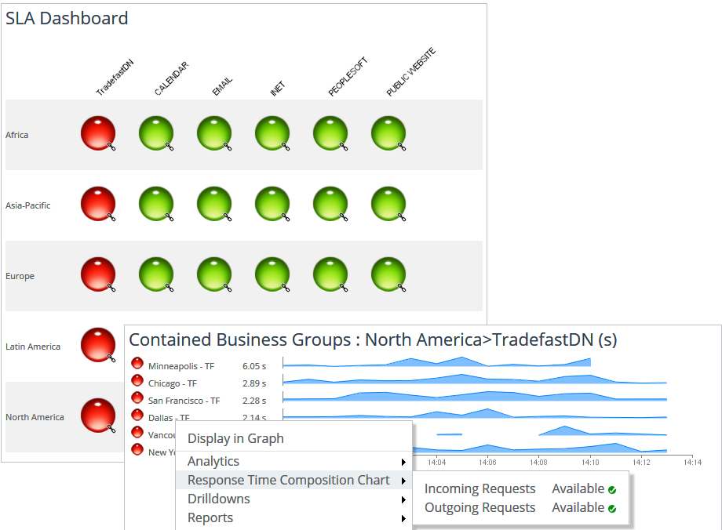
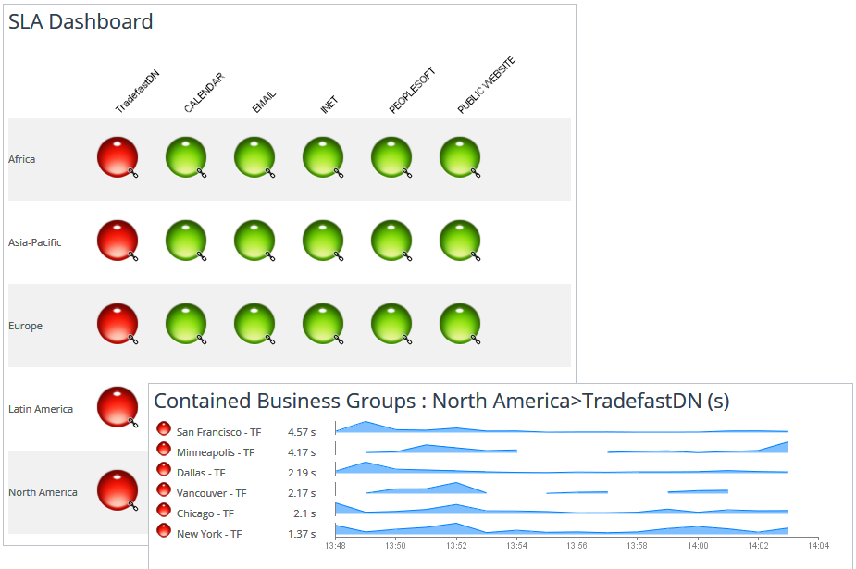
查看North America区域的用户
使用右键菜单查看 Response Time Composition Chart （RTCC，响应延时构成图）
Response Time Composition Chart (RTCC) 能够帮助分析延迟影响是由网络还是应用引起的
Notes:
The SLA Dashboard allows operations or IT management an instance status on the overall health of an application. We can clearly see across the user communities if a particular issue is affecting one group or the entire group. This allows the user to reconcile an open ticket. Meaning if Sally from accounting opens a ticket saying that TradeFast is slow can we determine if Sally is experiencing poor performance and does this poor performance affect other groups as well.
The SteelCentral dashboards are role-based, so an Executive may have a view of the SLA dashboard without the ability to drilldown or view other dashboards. As a troubleshooter, I am going to start my incident triage from the SLA dashboard by drilling down into North America to see if all locations are impacted by this slowdown.
Here we see that all locations are impacted. We can drilldown into the Response Time Composition Chart (RTCC) to see if the slowdown is possibly related to the network or application.

Slide 17
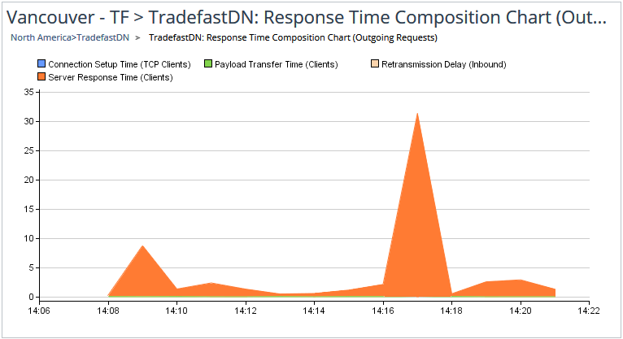
RTCC
Server Response time （服务器响应时间）贡献了最大的延迟，说明问题主要在应用层面
Notes:
SteelCentral automatically analyzes application performance from all locations. In this case, we see that most of our delay is caused Server Response Time, or, in other words, waiting on the application environment to respond to the user’s request. This tells us we need to focus our triage efforts on the application infrastructure, so let’s drilldown into our TradeFast End User Experience dashboard.

Slide 18
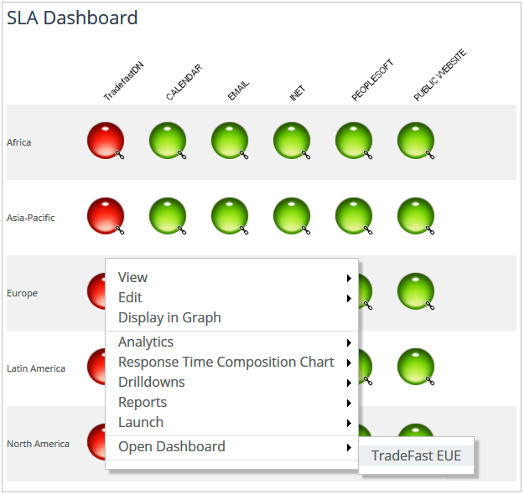
查看 TradeFast EUE Dashboard
钻取到具体应用，查看EUE
使用右键菜单进入TradeFast EUE Dashboard
EUE – End User Experience
Notes:
Without closing the RTCC, Right Click on North America / Open Dashboard / TradeFast EUE

Slide 19
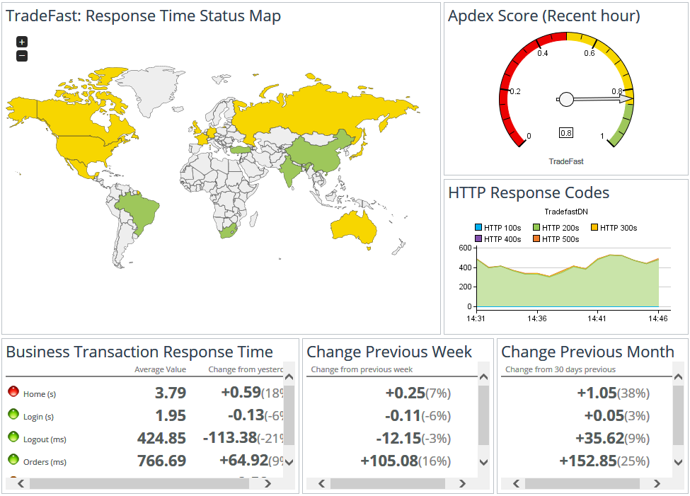
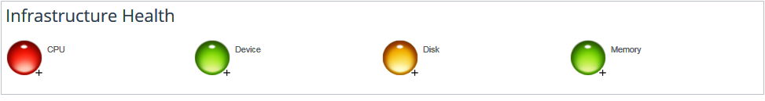
TradeFast 应用仪表板
详细了解应用的性能状况
Response Time Status Map 显示平均响应时间
Apdex值为0.7，表明EUE不好
HTTP 返回码显示页面加载正常
响应时间相比之前有增加
CPU与磁盘利用率高。通过Apdex 来进一步查看 具体交易的性能状况
Notes:
This view provides us a good overview of the TradeFast application from the end user’s perspective.
We can see the user experience from around the world, we can see response time for individual business transactions now and over time, we see the HTTP response codes, and a high level view of the infrastructure health.
We also see the Apdex score for the TradeFast application. The Apdex Score is an industry standard way to better understand the end user experience by giving weight to outliers that often get lost in the averages. Understanding the outliers will help you improve performance for all.
The Apdex Status page shows user performance and response time information from around the world. The Response Time Status Map shows average response time. In many cases, this view may be green or a country or two may be yellow. Averages are good, but we need to looks beyond them to understand overall performance. The gauge on the right shows an Apdex Score of .7 which tells us that we do not have a satisfactory end user experience. This is could be caused by too many outlying poor performers which lead to abandonment and loss of sales.
In this view, we see that our Apdex score is .6. Not good. The HTTP response codes tell us that almost all our pages are successfully loading, so we can rule out an unavailable app or server error, but we do notice that response time has increased over the past week and the past 30-days.
Let’s see what could be causing this.

Slide 20
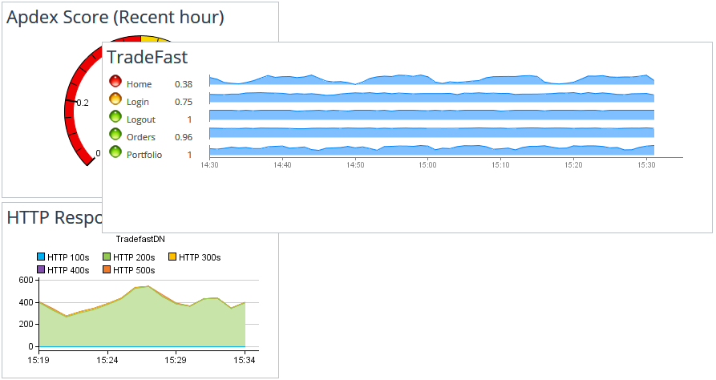
查看Apdex score panel具体信息
Home 和 Login 页面访问的性能不好
右键点击 Home页面行来进一步查看

Slide 21
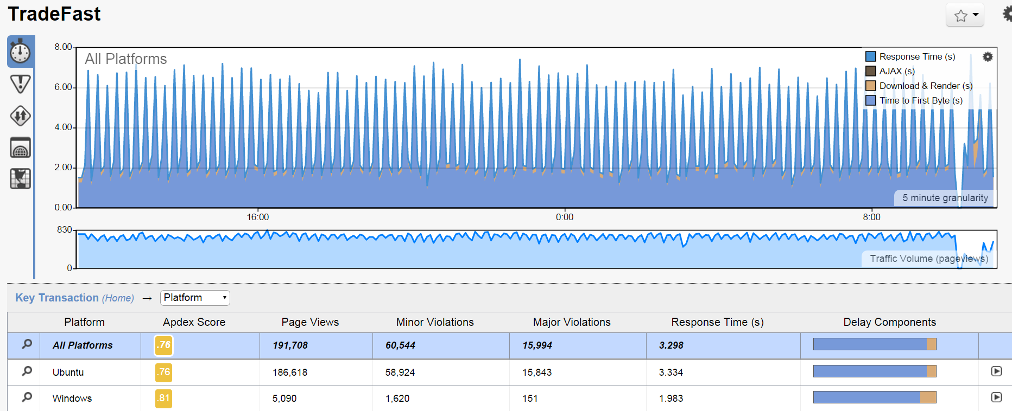
Home页面交易的状况
交易分布与延迟分解
页面延迟主要是在“Time to First Byte delay”— 服务器慢

Slide 22
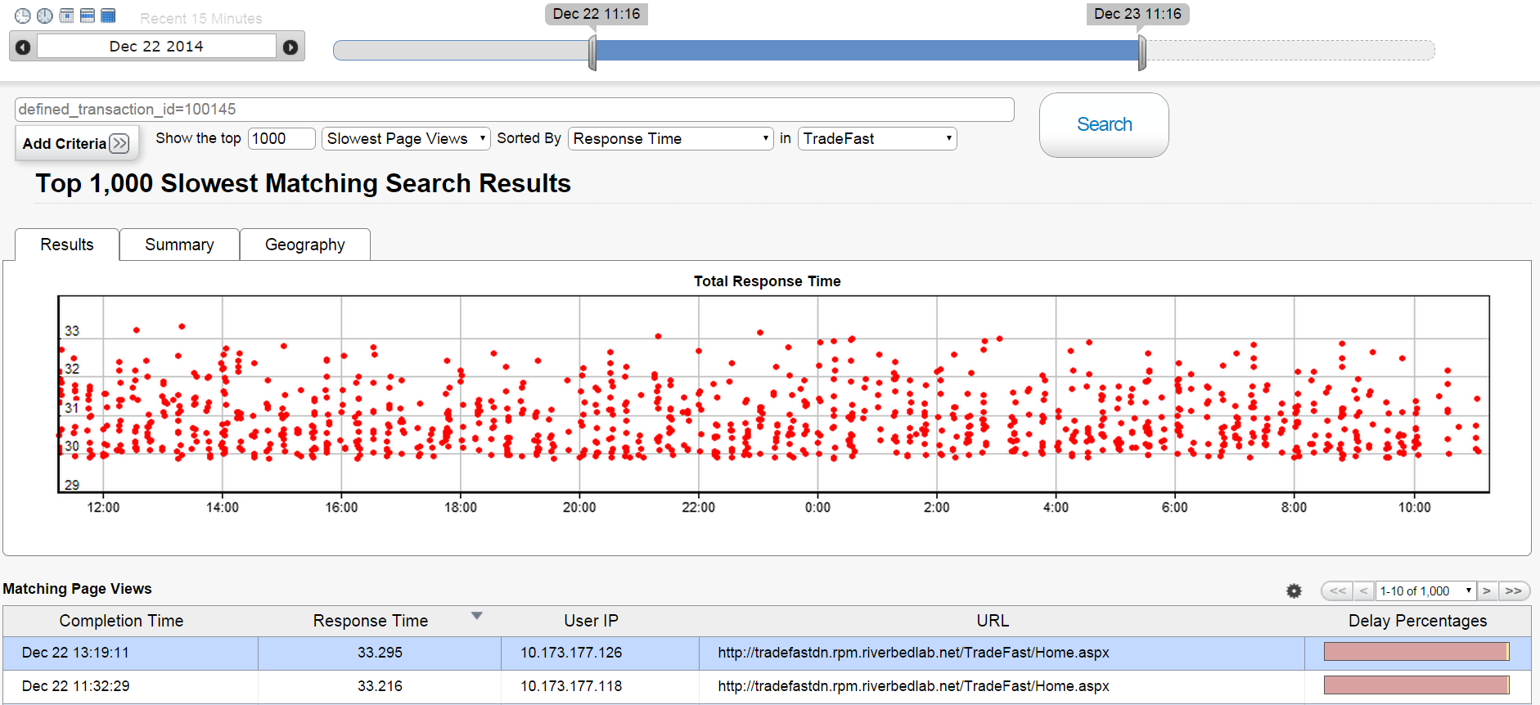
交易数据的全景展现
捕获并存储每一笔端到端交易
Scroll Down
Home页面的延迟主要是由于服务器慢引起的

Slide 23
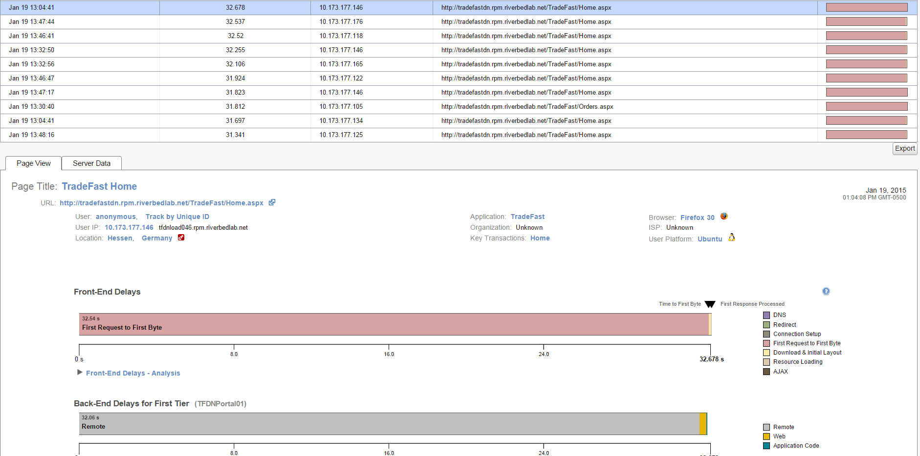
查看具体单笔交易的细节
前端延迟与后端延迟分解
前端延迟数据由自动嵌入页面的 JavaScript 小程序获取
Notes:
To the right, point out that by automatically injecting a JavaScript snippet into a page with the AppInternals collector, aka Web Analyzer, we can determine the amount of time it takes to establish DNS, how long it takes for any redirection, how long it takes to make the actual connection, the amount of time for the first byte of information to be returned to the browser, the time from the first byte to when the page begins to render, resource loading which is the amount of time to fully render the page as well as the time it takes for any initial AJAX call to be returned to the page.
Note that below the Front-End Delays, there is also a timeline of delays for the Back-End for the first-tier of the back-end servers. In this case, we see that the backend delay is almost as long as the front end delay, so we need to dig deeper into the application infrastructure.

Slide 24
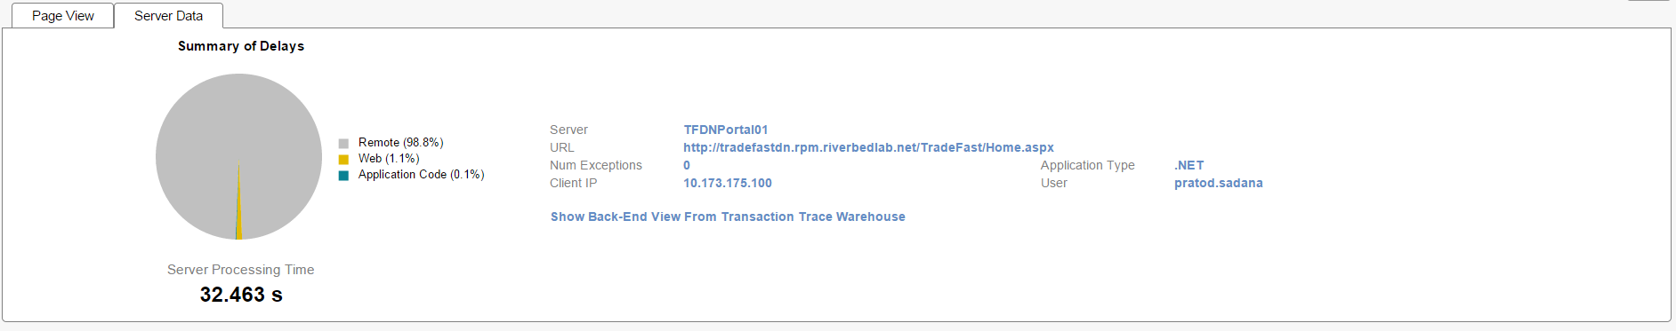
找出服务器侧的瓶颈
查看后端延迟的构成成分
服务器处理延迟占用了超过 30 秒
点击 “Show Back-End View . . .”
“Remote”占用了大部分服务器处理时间 --- 继续点击来查看代码层面的运行情况
Notes:
The Server Data tab gives more details where possible delays may be coming from - Web, Application code, Database or other Remote calls. We can dissect the backend transaction and find the bottlenecks on the server side. Clicking the “Show Back End View from Transaction Trace Warehouse” link, which gives us a per transaction map of delay for the backend multi- tier transaction inside of the Transaction Tdrace Warehouse for that transaction.

Slide 25
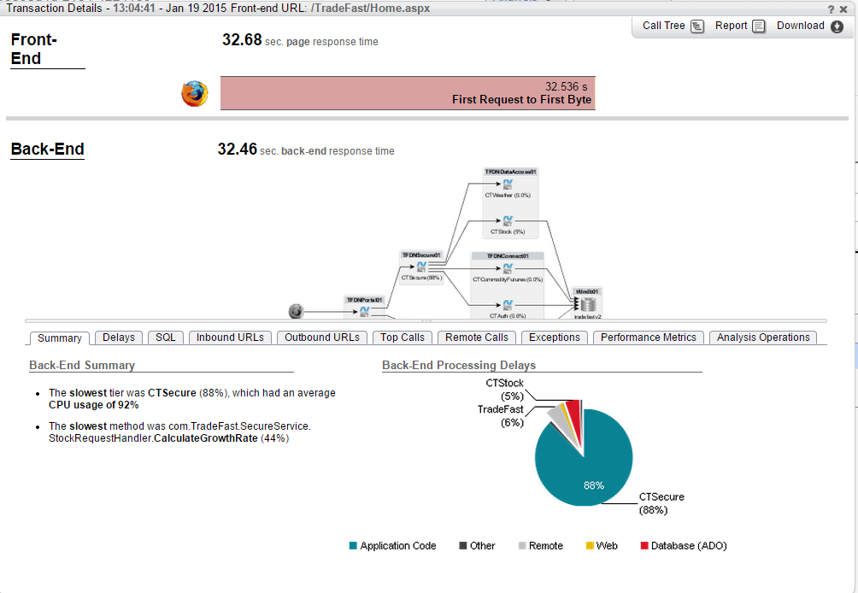
找出最慢的应用模块（tiers）
最慢的模块是 CTSecure
最慢的方法是 CalculateGrowthRate
找到了导致问题的关键应用模块，接下来只需找到对应负责的专家来解决问题！
Notes:
The dynamic map is helpful because it helps us isolate the issue to only those servers involved in this transaction. With AppInternals, I don’t have to look at the fifty servers in my environment. I can focus my efforts on only those five servers that were used during this transaction.
The Back-End Summary helps us further narrow our focus by identifying components that could be contributing to our slow response time. With this summary, I can systematically work with those domain specialists who can help resolve this issue while not bothering those specialists who do not need to be involved. In this view, we see that there is high CPU utilization and possibly slow methods, so I can start my resolution efforts with those teams and leave the network and database teams, for example, alone for now.
On the right, we see a breakdown of the backend processing delay. We see that 88% of our time was spent on CTSecure and the lowest method, CalculateGrowthRate, accounted for 44% of our processing time. Since this is the case, I want to click on the Top Calls tab to see my top calls.

Slide 26
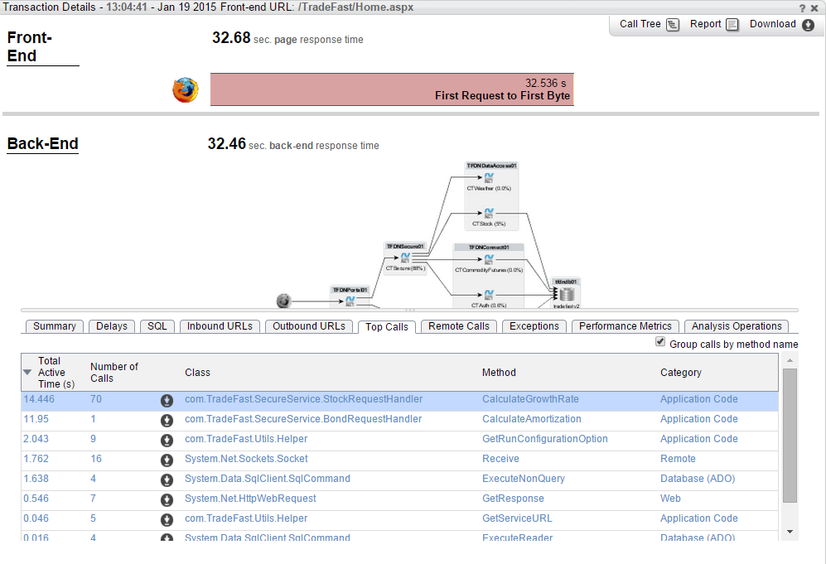
最频繁的调用
方法CalculateGrowthRate 运行了70次，总共用了14.4秒
方法CalculateAmortization 用了12秒
这些调用的执行时间超出正常水平 --- 分享这些信息给研发团队，快速修复
Notes:
Here we see two potential issues. CalculateGrowthRate ran 70 times for a total of 14.4 seconds, or roughly 2 seconds per call. Should it be called this many times? This is a good question for our development team. A better question would be why did the one CalculateAmortization method take almost 12 seconds? Click on that Method to drill down into the call tree.

Slide 27
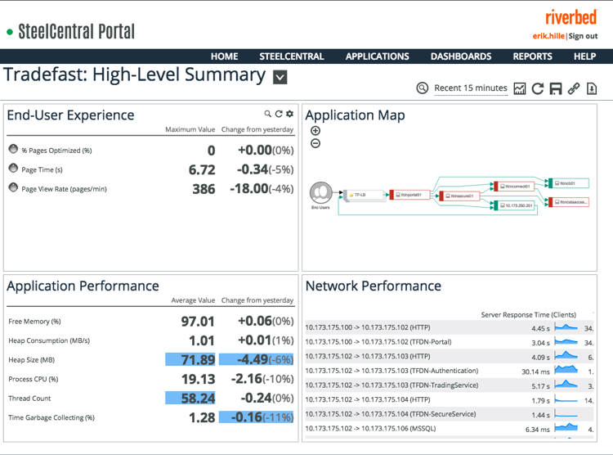
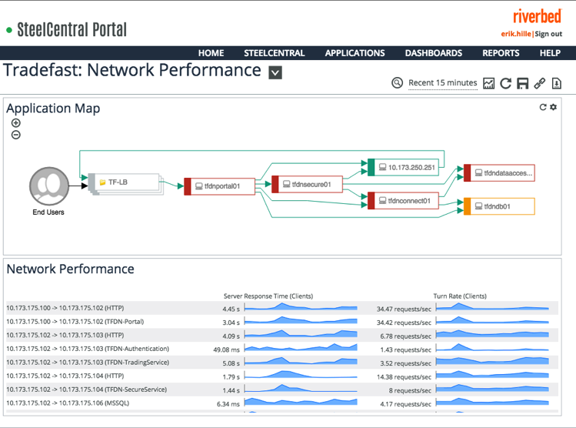
使用SteelCentral Portal，您能够…
跨团队协作
共享数据、信息
综合不同性能域的数据
改善 MTTR

Slide 28
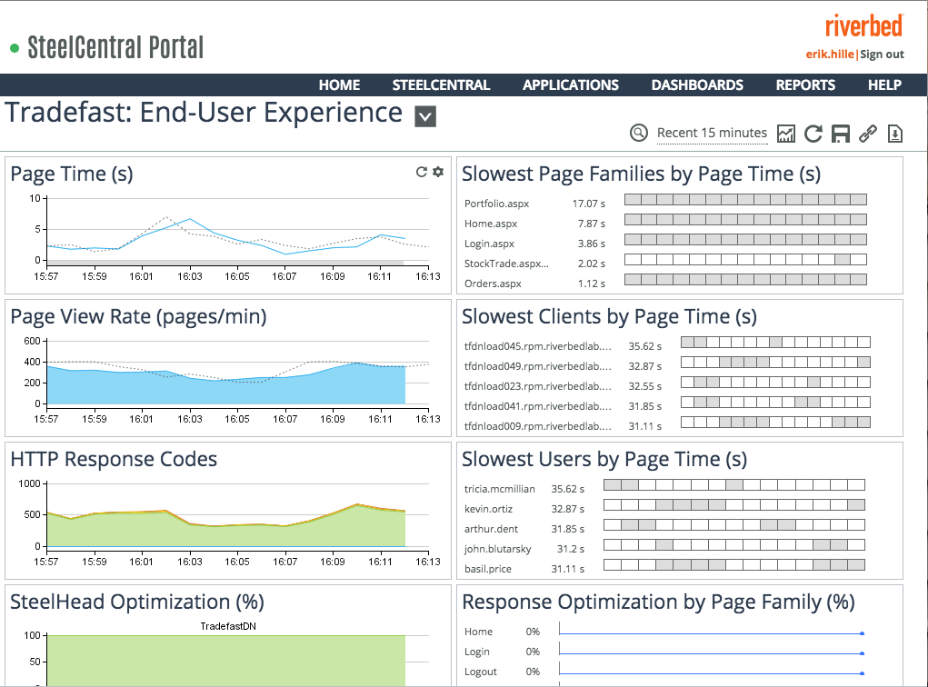
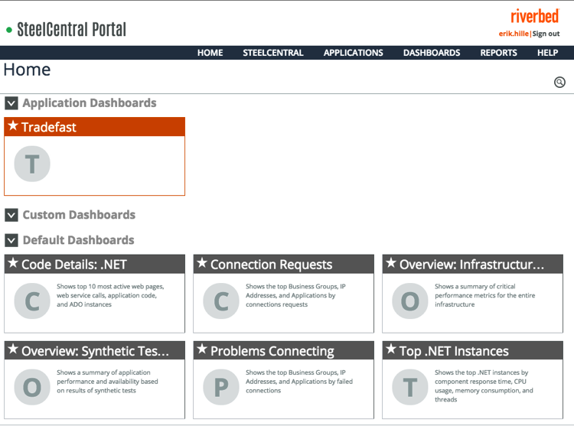
使用 SteelCentral Portal，您能够 …
给关键人员提供有意义的数据
为IT专家提供经过定制的数据
多角度的视图

